Slide 1
British Airways
Customer ratings analysis and insights
08-08-2024

Slide 2
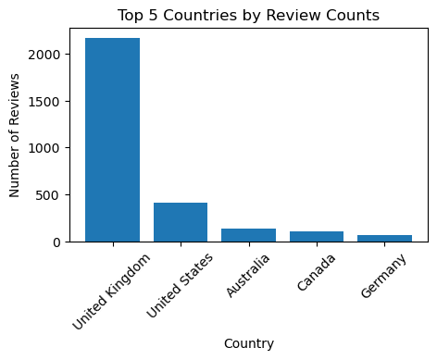
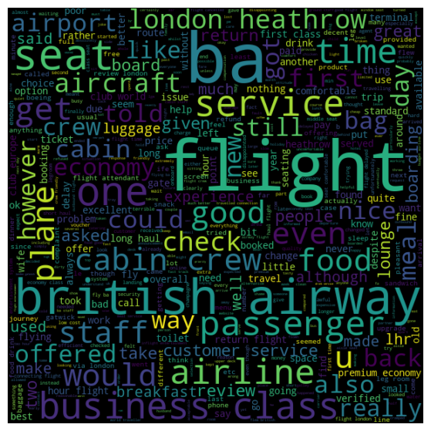
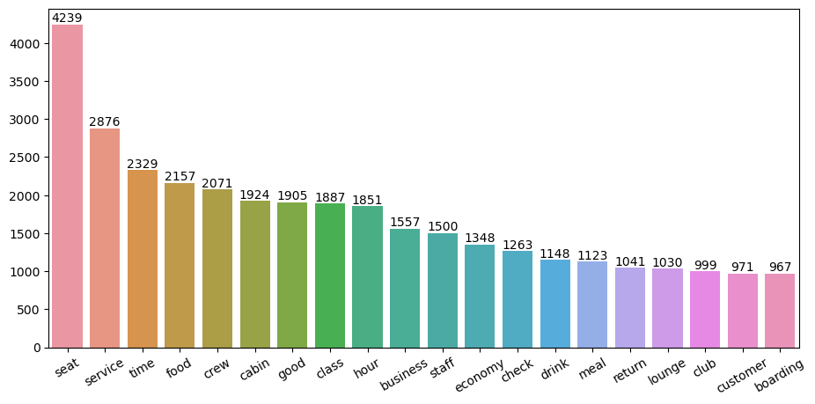
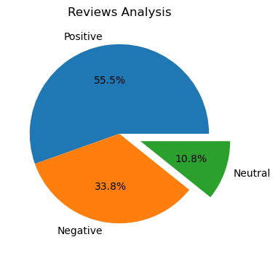
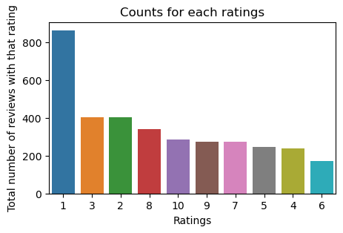
Key metrics
Average Overall Rating
4.58 /10
Reviews from 70 Countries
3495 Total reviews
collected
From cleaning 3495 reviews, we obtain
Positive Reviews - 1938
Negative Reviews - 1181
Neutral Reviews - 376
All Customers liked Cabin crew service and staff, general economy seats. Many travelled in Business class.
Focus on – Economy class service, seats, enhance inflight entertainment experience and importantly Delays. Enhance the experience of business class, it seems customers want value for money. Improve Customer service on refund requests and process.

